Slide 1
ENGR-304-L
Software Lab 05

Slide 2
Agenda
Attendance
Recap
Masking
IO Devices
Assembly with IO Devices
Getting Started

Slide 3
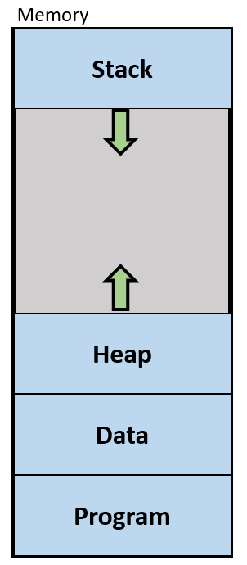
Recap
The stack is memory used to protect values of registers when function calls are made
The stack grows towards program and data memory

Slide 4
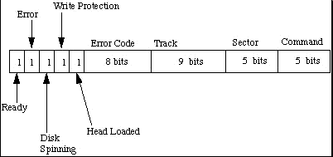
Bit-Masks
Recall protocols & bit-fields
https://users.cs.cf.ac.uk/Dave.Marshall/C/drive.gif

Slide 5
Bit-Masks
Recall protocols & bit-fields
How do we get just the
“Write Protection” bit?
https://users.cs.cf.ac.uk/Dave.Marshall/C/drive.gif

Slide 6
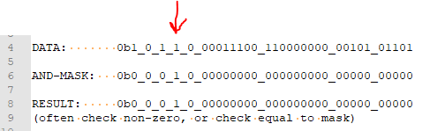
Bit-Masks
How do we get just the
“Write Protection” bit?
https://users.cs.cf.ac.uk/Dave.Marshall/C/drive.gif

Slide 7
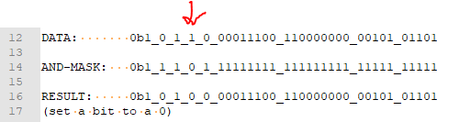
Bit-Masks
How do we set just the
“Write Protection” bit to 0?
https://users.cs.cf.ac.uk/Dave.Marshall/C/drive.gif

Slide 8
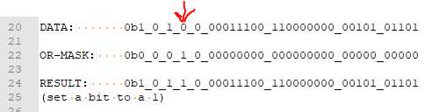
Bit-Masks
How do we set just the
“Write Protection” bit to 1?
https://users.cs.cf.ac.uk/Dave.Marshall/C/drive.gif

Slide 9
Bit-Masks
How might we fill a register
with just the “track” bits?
Think for a while…
https://users.cs.cf.ac.uk/Dave.Marshall/C/drive.gif

Slide 10
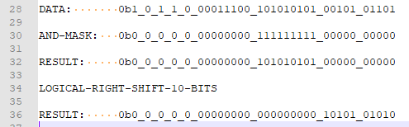
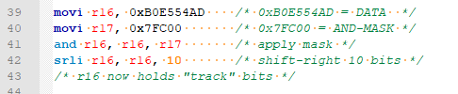
Bit-Masks
How might we fill a register
with just the “track” bits?
Think for a while…
https://users.cs.cf.ac.uk/Dave.Marshall/C/drive.gif

Slide 11
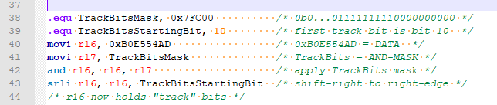
Bit-Masks
Note .equ constants for readability & maintainability

Slide 12
Register Bit-Masks
More assembly and masking examples in NIOS IO slide deck!

Slide 13
Types of I/O Systems
I/O Devices
LEDs
Keyboards
Switches
Displays
…

Slide 14
Types of I/O Systems
I/O Devices
LEDs
Keyboards
Switches
Displays
…
Receive data from input devices
Send data to output devices

Slide 15
Types of I/O Systems
I/O Devices
LEDs
Keyboards
Switches
Displays
…
Receive data from input devices - like read data from memory
Send data to output devices - like write data to memory

Slide 16
Types of I/O Systems
Options:
Separate Memory & I/O Address Spaces (Intel)
Unified Address Spaces (Motorola, NIOS)
Unified Address Spaces
Inputs performed with ldwio, a non-caching ldw
Outputs performed with stwio, a non-caching stw

Slide 17
Types of I/O Systems
Options:
Separate Memory & I/O Address Spaces (Intel)
Unified Address Spaces (Motorola, NIOS)
Unified Address Spaces
Inputs performed with ldwio, a non-caching ldw
Outputs performed with stwio, a non-caching stw
Addresses not used for memory may be used for I/O devices
Each device is allocated a certain range of addresses
Bit-Fields within that range of addresses are defined to have certain meaning to the device

Slide 18
PIO & Timer Devices
PIO Core Devices
General Purpose I/O
Nice for “banks” of 2-state (1-bit, on/off) devices, ex: LEDs & Switches

Slide 19
PIO & Timer Devices
PIO Core Devices
General Purpose I/O
Nice for “banks” of 2-state (1-bit, on/off) devices, ex: LEDs & Switches
Timer Device
Commonly needed / application-independent device
Has both input (configuration) and output (timing state)

Slide 20
PIO & Timer Devices
PIO Core Devices
General Purpose I/O
Nice for “banks” of 2-state (1-bit, on/off) devices, ex: LEDs & Switches
Timer Device
Commonly needed / application-independent device
Has both input (configuration) and output (timing state)
Note:
Addresses are byte-addressed
Offsets are by-word (4-bytes)
Effective Address = Port_Base_Address + 4*offset

Slide 21
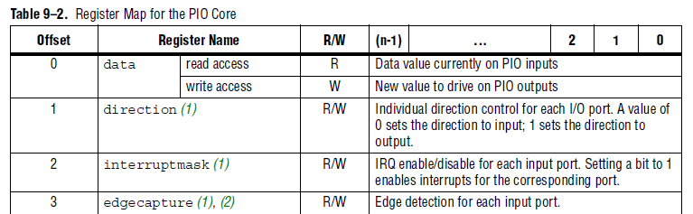
PIO Core (Peripheral I/O device/port)

Slide 22
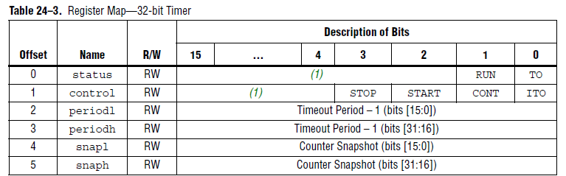
Interval Timer Core

Slide 23
Lab Components
Altera DE2 Board
Windows 10 PC
Quartus
FGPA
Peripheral Devices
(Ex: switches, buttons, hex displays)
NIOS Processor Image
NIOS Processor Image
(Flashed)
Switches
Keys
Software (Executing)
Altera DM
LEDs
NIOS Processor Image
7Seg Displays
Timer
Software (Loading/Debugging)

Slide 24

PIO & Timer Devices
Recommended Approach:
Define .equ constants for all I/O device base addresses
Define .equ constants for offsets (in bytes) to each I/O register
Load the current device’s base address constant into a register
Use stwio and ldwio with the register and the offset constant

Slide 25
Lab SW05 Tips
Don’t forget to initialize IO devices before use (if needed)
Use .equ constants instead of hardcoding immediate values
The .equ constants can be placed anywhere that an immediate value can be, including stwio offsets
Immediate (.equ) values can be written in decimal, hex (0x) or binary (0b)
Refer to “NIOS IO” slide deck for details on masking & IO devices

Slide 26
Getting Started
Setup project directory for SW05 on the H: drive
Download SW05 files from Moodle or S: drive
Note that there are new reference files for this lab, the ones from previous labs also still apply
Start following directions in the lab assignment document

